Slide 1

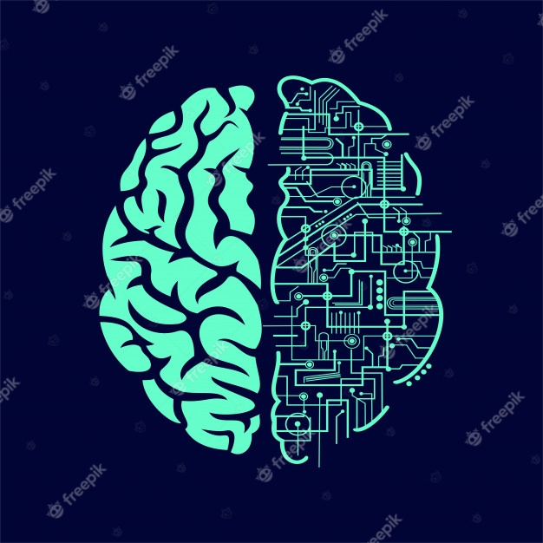
Prediction of biological environment from MRI scans, by Linear Regression & ML methods
By David Cohen
Advisor: Professor Aviv Mezer

Slide 2
Background
qMRI – Quantitative indices of MRI Scanning.
Lipid and Iron has linear influence on qMRI results
Biological environment of protons may be essential at disease detection and brain research

Slide 3
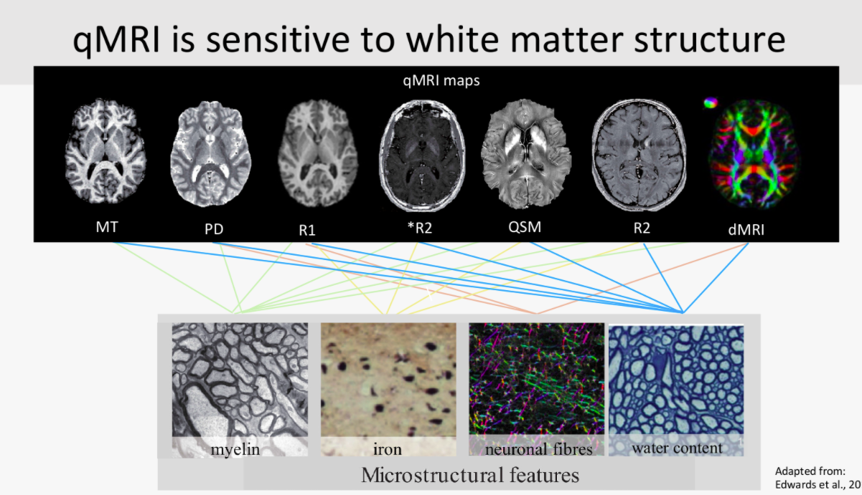

Slide 4

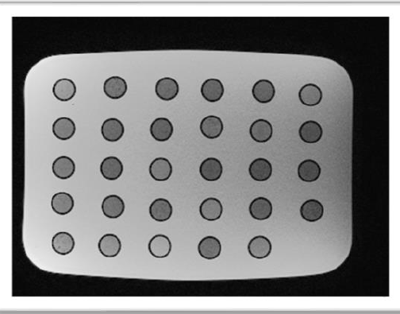

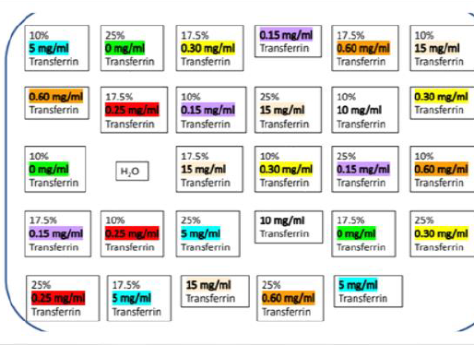
The Data
about 500 samples of water solutions, in the presence of different lipids and iron content (free ions, and protein-bounded).

Slide 5

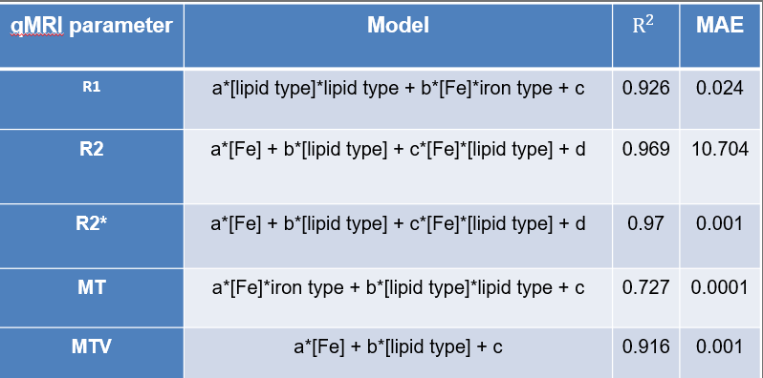

Based on a study done last year that models the MRI results given the biological measurements

Slide 6
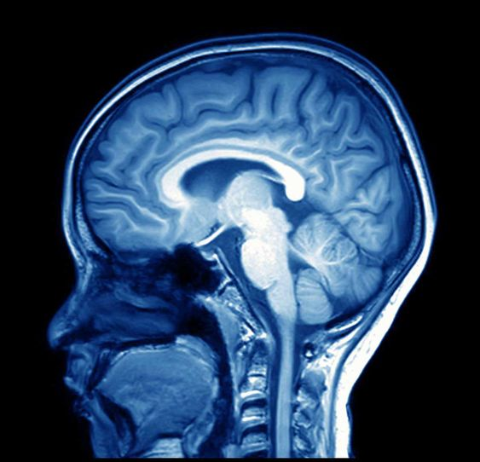
Our goal : Prediction of biological environment from MRI scans
Start with linar regressin on qMRI result (“biased approach”).
continue with A.I methods(“unbiased approach”)

Slide 7

Any questions?

